Slide 1
TCS Day : Cloud Workshop — Saurav Raiguru Developer Advocate, Developer Ecosystems Group

Slide 2
Legal Notice
Copyright © 2018 by International Business Machines Corporation. All rights reserved.
No part of this document may be reproduced or transmitted in any form without written permission from IBM Corporation.
IBM, the IBM logo, and ibm.com, and (ADDITIONAL TRADEMARKS HERE) are trademarks of International Business Machines Corp., registered in many jurisdictions worldwide. Other product and service names might be trademarks of IBM or other companies. A current list of IBM trademarks is available on the web at “Copyright and trademark information” at ibm.com/legal/copytrade.shtml.
Product data has been reviewed for accuracy as of the date of initial publication. Product data is subject to change without notice. This document could include technical inaccuracies or typographical errors. IBM may make improvements and/or changes in the product(s) and/or program(s) described herein at any time without notice. Any statements regarding IBM's future direction and intent are subject to change or withdrawal without notice, and represent goals and objectives only. References in this document to IBM products, programs, or services does not imply that IBM intends to make such products, programs or services available in all countries in which IBM operates or does business. Any reference to an IBM Program Product in this document is not intended to state or imply that only that program product may be used. Any functionally equivalent program, that does not infringe IBM's intellectually property rights, may be used instead.
THE INFORMATION PROVIDED IN THIS DOCUMENT IS DISTRIBUTED "AS IS" WITHOUT ANY WARRANTY, EITHER OR IMPLIED. IBM LY DISCLAIMS ANY WARRANTIES OF MERCHANTABILITY, FITNESS FOR A PARTICULAR PURPOSE OR NONINFRINGEMENT. IBM shall have no responsibility to update this information. IBM products are warranted, if at all, according to the terms and conditions of the agreements (e.g., IBM Customer Agreement, Statement of Limited Warranty, International Program License Agreement, etc.) under which they are provided. Information concerning non-IBM products was obtained from the suppliers of those products, their published announcements or other publicly available sources. IBM has not tested those products in connection with this publication and cannot confirm the accuracy of performance, compatibility or any other claims related to non-IBM products. IBM makes no representations or warranties, express or implied, regarding non-IBM products and services.
The provision of the information contained herein is not intended to, and does not, grant any right or license under any IBM patents or copyrights. Inquiries regarding patent or copyright licenses should be made, in writing, to:
IBM Director of Licensing
IBM Corporation
North Castle Drive
Armonk, NY 1 0504- 785
U.S.A.

Slide 3
Agenda
Sign up – IBM Cloud (Pre-req)
App Modernization – Docker - Container and K8s
IBM Cloud and Kubernetes Service
Hands On (40 mins)
– Deploy the application
– Access the application , Scale the Application
– Delete the application

Slide 4
Pre-requisite
IBM Cloud account Sign up (Using official id)
https://ibm.biz/BdzPaf
https://cloud.ibm.com
You should have access the following URLs
http://bit.ly/tcskube

Slide 5
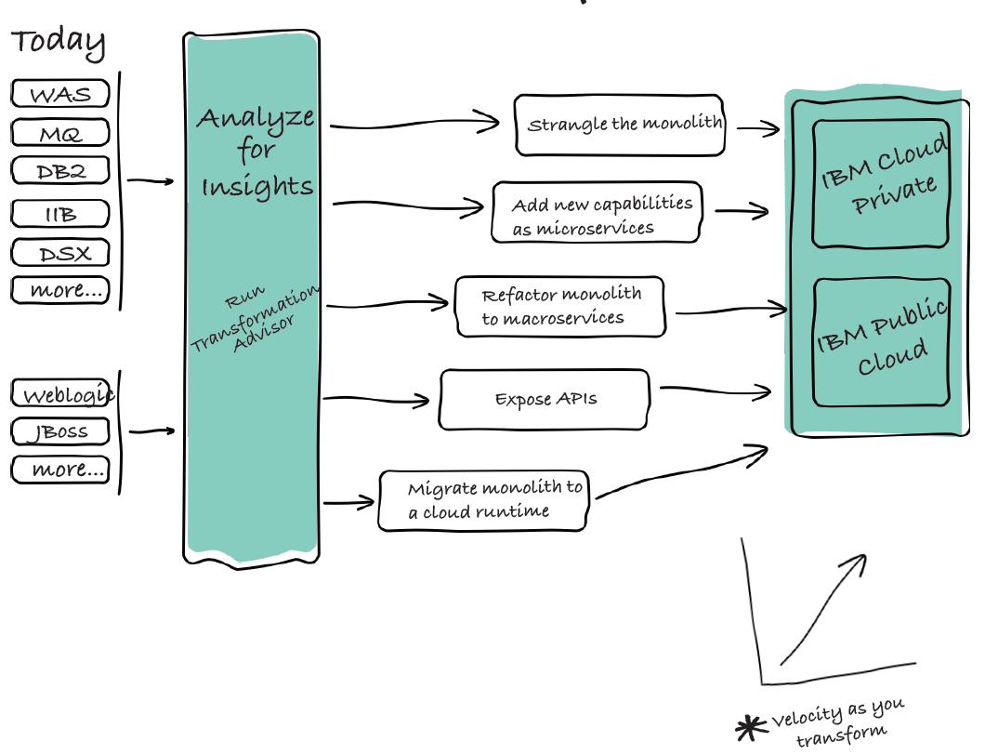
Application modernization journey
Containerize the monolith. Reduce costs and simplify operations.
Expose on-prem assets with APIs. APIs enable legacy assets that are difficult to cloud enable.
Refactor into microservices. Break down monoliths into deployable components.
Add new microservices. Innovate incrementally and establish success early.
Strangle the monolith. Incrementally sunset the monolith.

Slide 6
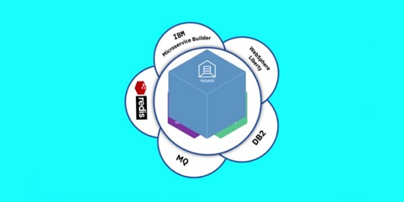
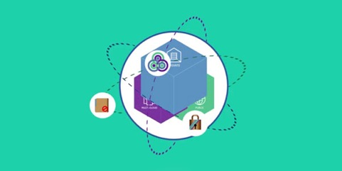
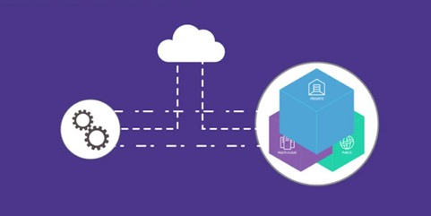
Use Cases
Create new cloud-native apps
Streamline development with built-in microservices, runtimes,
containers and Kubernetes orchestration plus integrated management.
Modernize your heritage apps on cloud
Move your apps as-is to the cloud or re-factor an app and use it in new development and application workload models.
Open your data center to work with cloud services
Protect and leverage your in-house data and pull in external

Slide 7




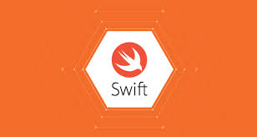














Industry Cloud Native Platform
Language Runtimes
Developer Catalog
(Cloud Paks, Packaged Middleware Services, Services, Operators)
Containers (Full K8s)
Services & Functions
Apps (CF)
OpenWhisk
Cloud Foundry
IBM Managed
Client Managed
Developer Experience (Microclimate and Dev Tools)
DevOps (Build Pipelines)
Knative (Serving, Eventing, Build Pipelines)
Istio (Service Mesh - Traffic management, Policy, Telemetry, Key/Cert management)
Kubernetes (Container orchestration and resource management)
containerD (Container runtime)
7
Multicloud Manager
IBM Public Cloud
IBM Private Cloud

Slide 8
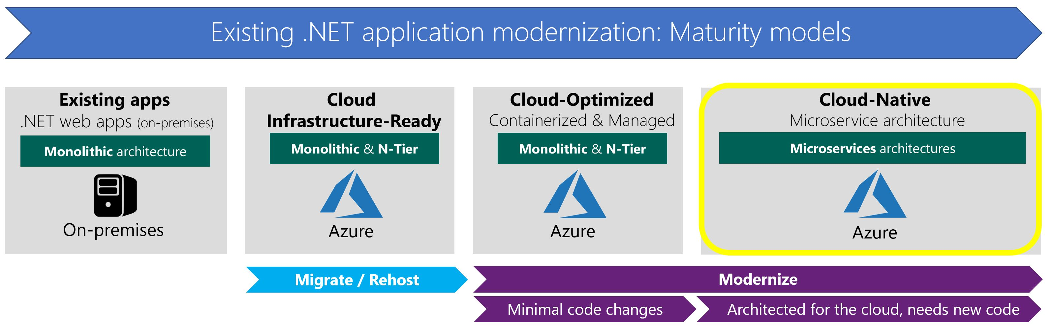

Modernization maturity level to Cloud-Optimized applications

Slide 9
Lets understand basics of Container, K8s

Slide 10


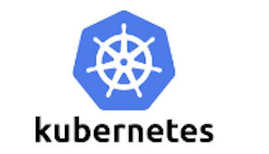


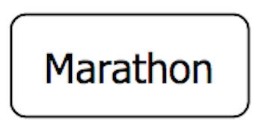


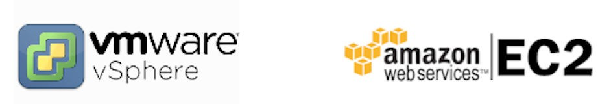
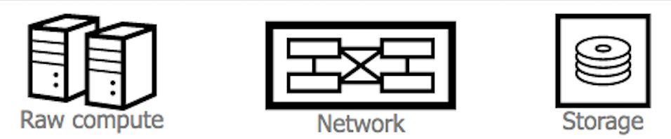
Layers
Slide Title Goes Here
Layer 6
Development Workﬂow Opinionated Containers
Layer 5
Orchestration/Scheduling Service Model
Layer 4
Container Engine
Layer 3
Operating System
Layer 2
Virtual Infrastructure
Layer 1
Physical Infrastructure

Slide 11

What are containers?
Benefits of using containers
A standard way to package an application and all its dependencies so that it can be moved between environments and run without change
Work by hiding the differences between applications inside the container so that everything outside the container can be standardized
Docker: provides a standard way to create images for Linux Containers
Can run on many different platforms
Processes share OS resources, but remain segregated
Isolate the different requirements between the applications that run inside the container, and the operations that run outside the container
Quick and easy to create, delete, start, stop, download, and share
Use hardware resources more efficiently than virtual machines, and are more lightweight
Can be treated as unchangeable
App A
bins/libs
Guest OS
App B
bins/libs
Guest OS
App B
bins/libs
Guest OS
Virtual machines
App A
containers
App B
App B
App C
App C App C
bins/libs
bins/libs
bins/libs
Host OS
Hypervisor
Host OS
Server
Server
Containers are isolated, but share OS and, where appropriate, bins/libraries
11

Slide 12
Docker Flow - Demo
Command line Interface
Docker Engine

Slide 13
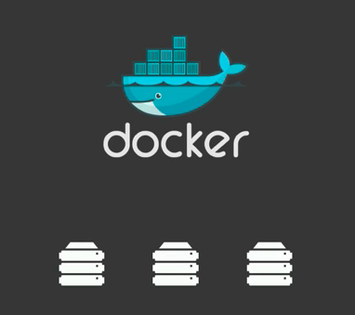
Deployed on 3 servers – Simple

Slide 14
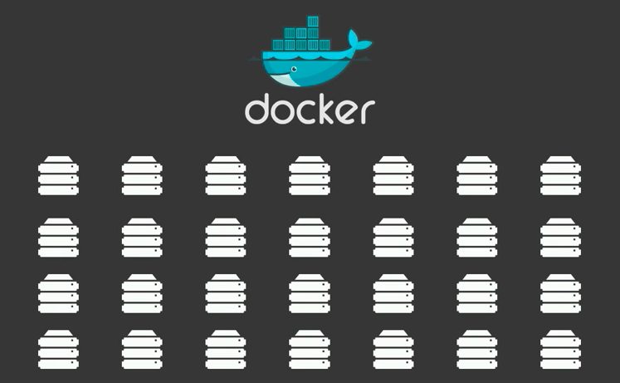
Jump from 3 – 40,50 servers
Scale out
Keep track
Where to put your containers
What container – Where?
May be containers other than docker as well
Containers are great but … can lead into lack of control & chaos

Slide 15

Kubernetes – (Κυβερνήτης - Captain in Greek)
Regain control with Containers and Kubernetes
Organize and Govern the Container Chaos

Slide 16
What is K8s?
Based on Google’s Borg & Omega - Open Source - Container Orchestrator
Open Governance
Cloud Native Compute Foundation
Adoption by Enterprise
RedHat, Microsoft, IBM and Amazon
Help to automate DevOps – Deployment, scaling and management of containerized apps
Helps organize container in logical units( pods, nodes)
Helps in resource monitoring and logging

Slide 17
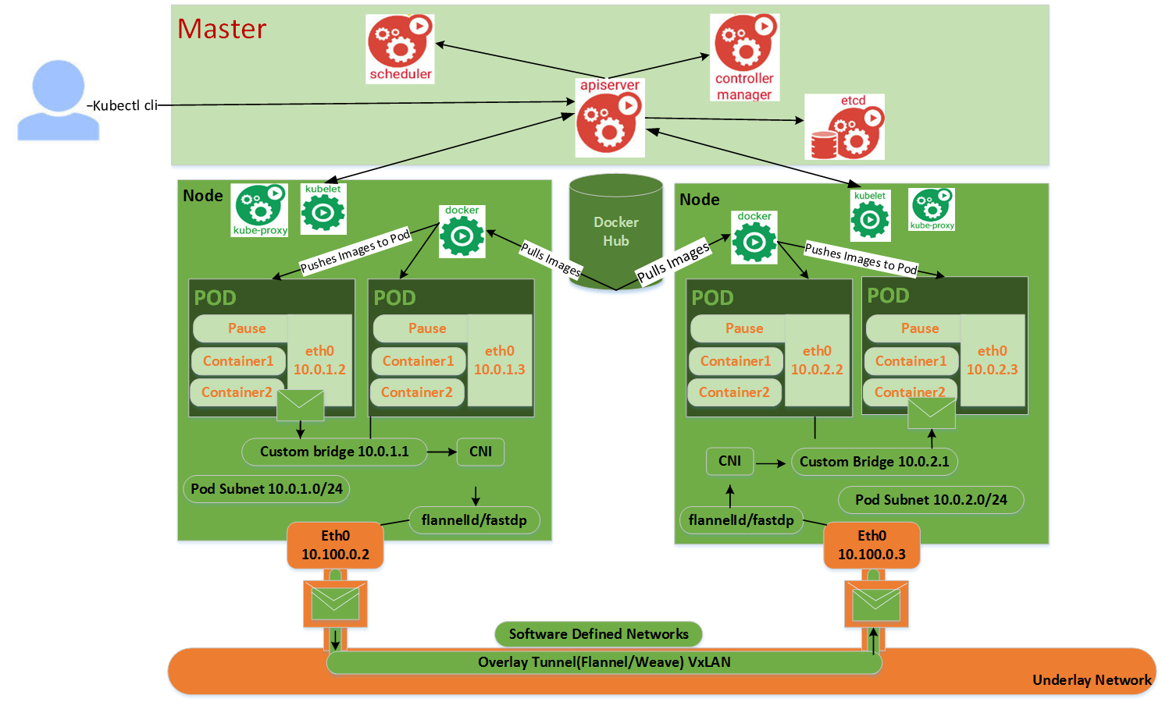
Kubernetes Architecture

Slide 18
Kubernetes from IBM
Public Cloud (IKS)
Dedicated/Private Cloud

Slide 19


Slide 20


A managed Kubernetes service providing an intuitive user experience with simplified cluster lifecycle management.
Built-in security and isolation to enable rapid delivery of apps, while leveraging IBM Cloud Services including Weather data, IoT, Analytics, or AI capabilities with Watson. Available in six IBM regions WW, including 25+ datacenters.
https://www.ibm.com/cloud/container-service
Kubernetes Certified Service Provider
Kubernetes Technology Partner
Kubernetes Service Providers
IBM Cloud Kubernetes Service | ©2019 IBM Corporation
Notes:
ISO 27001, ISO 27017, ISO 27018
EU-US Privacy Shield and Swiss-US Privacy Shield Framework
HIPAA ready
SOC 1, SOC 2 Type 1
ISAE 3402

Slide 21
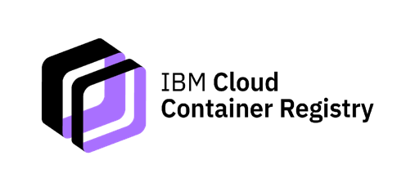
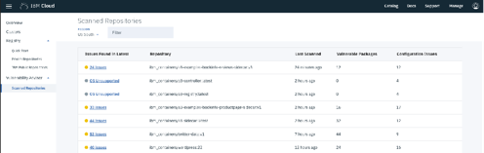
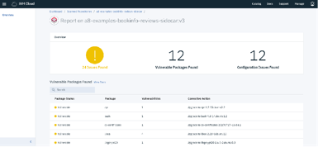
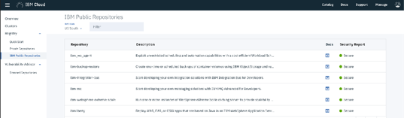
Product Definition
IBM managed stand-alone Docker image registry with integrated Vulnerability Advisor.
Value Proposition
IBM preferred image registry. Pre-integrated with our Kubernetes service. Secure with integration to IBM Identity and Access Manager. No need to configure and maintain storage for your images. Advanced capabilities such as vulnerability scanning, policy scanning, deployment policy enforcement, and integration to Docker Notary for image signing. The registry stores IBM curated content, open source, and customer provided images and Helm charts.
With our container service, users also have the option to deploy from an existing Docker registry (i.e., DockerHub, Quay, Artifactory, etc).
https://console.bluemix.net/docs/services/Registry/index.html
https://console.bluemix.net/docs/containers/va/va_index.html#va_index

Slide 22






Intelligent Scheduling
Self-healing
Horizontal scaling
Service discovery & load balancing
Automated rollouts and rollbacks
Secret and configuration management
IBM Cloud Kubernetes Service | ©2018 IBM Corporation

Slide 23
Cluster Management
Capabilities

Slide 24






Simplified cluster
management
Design your
own cluster
Container security
& isolation
Extend with IBM Cloud & Watson
Native open-source
experience
Integrated
operational tools
IBM Cloud Kubernetes Service | ©2018 IBM Corporation

Slide 25
Mentors
Arun Balasubramanyan
Sachin Jha
Saurav Raiguru

Slide 26
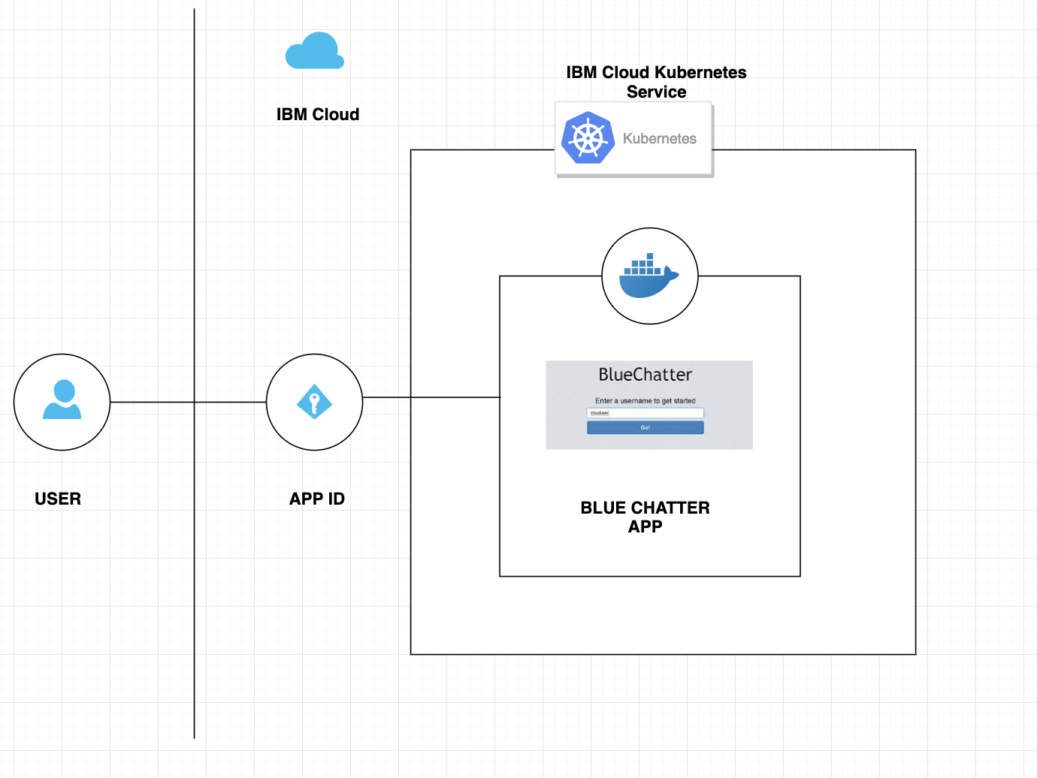
Hands On
Deploy microservice on IBM Cloud Kubernetes Cluster
Architectural Flow:
IKS ( k8s Managed Cluster) on IBM Cloud
Use Client (Kubectl) to Deploy App
Technology Stack (IBM Cloud):
Docker Container
Kubernetes
IBM Cloud - IKS
GuestBook
App

Slide 27
Pre-req
Covered in Lab Session
Pre-reqs
IBM Cloud Sign up
Task 1
IBM Cloud Sign In
Apply PROMO Code
Task 2
IBM K8s Free Cluster
Task 3
Microservice to be deployed on IBM k8s cluster
Task 4
Explore Scaling
Managing Resources

Slide 28
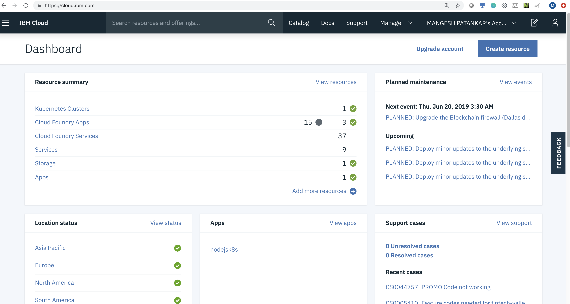
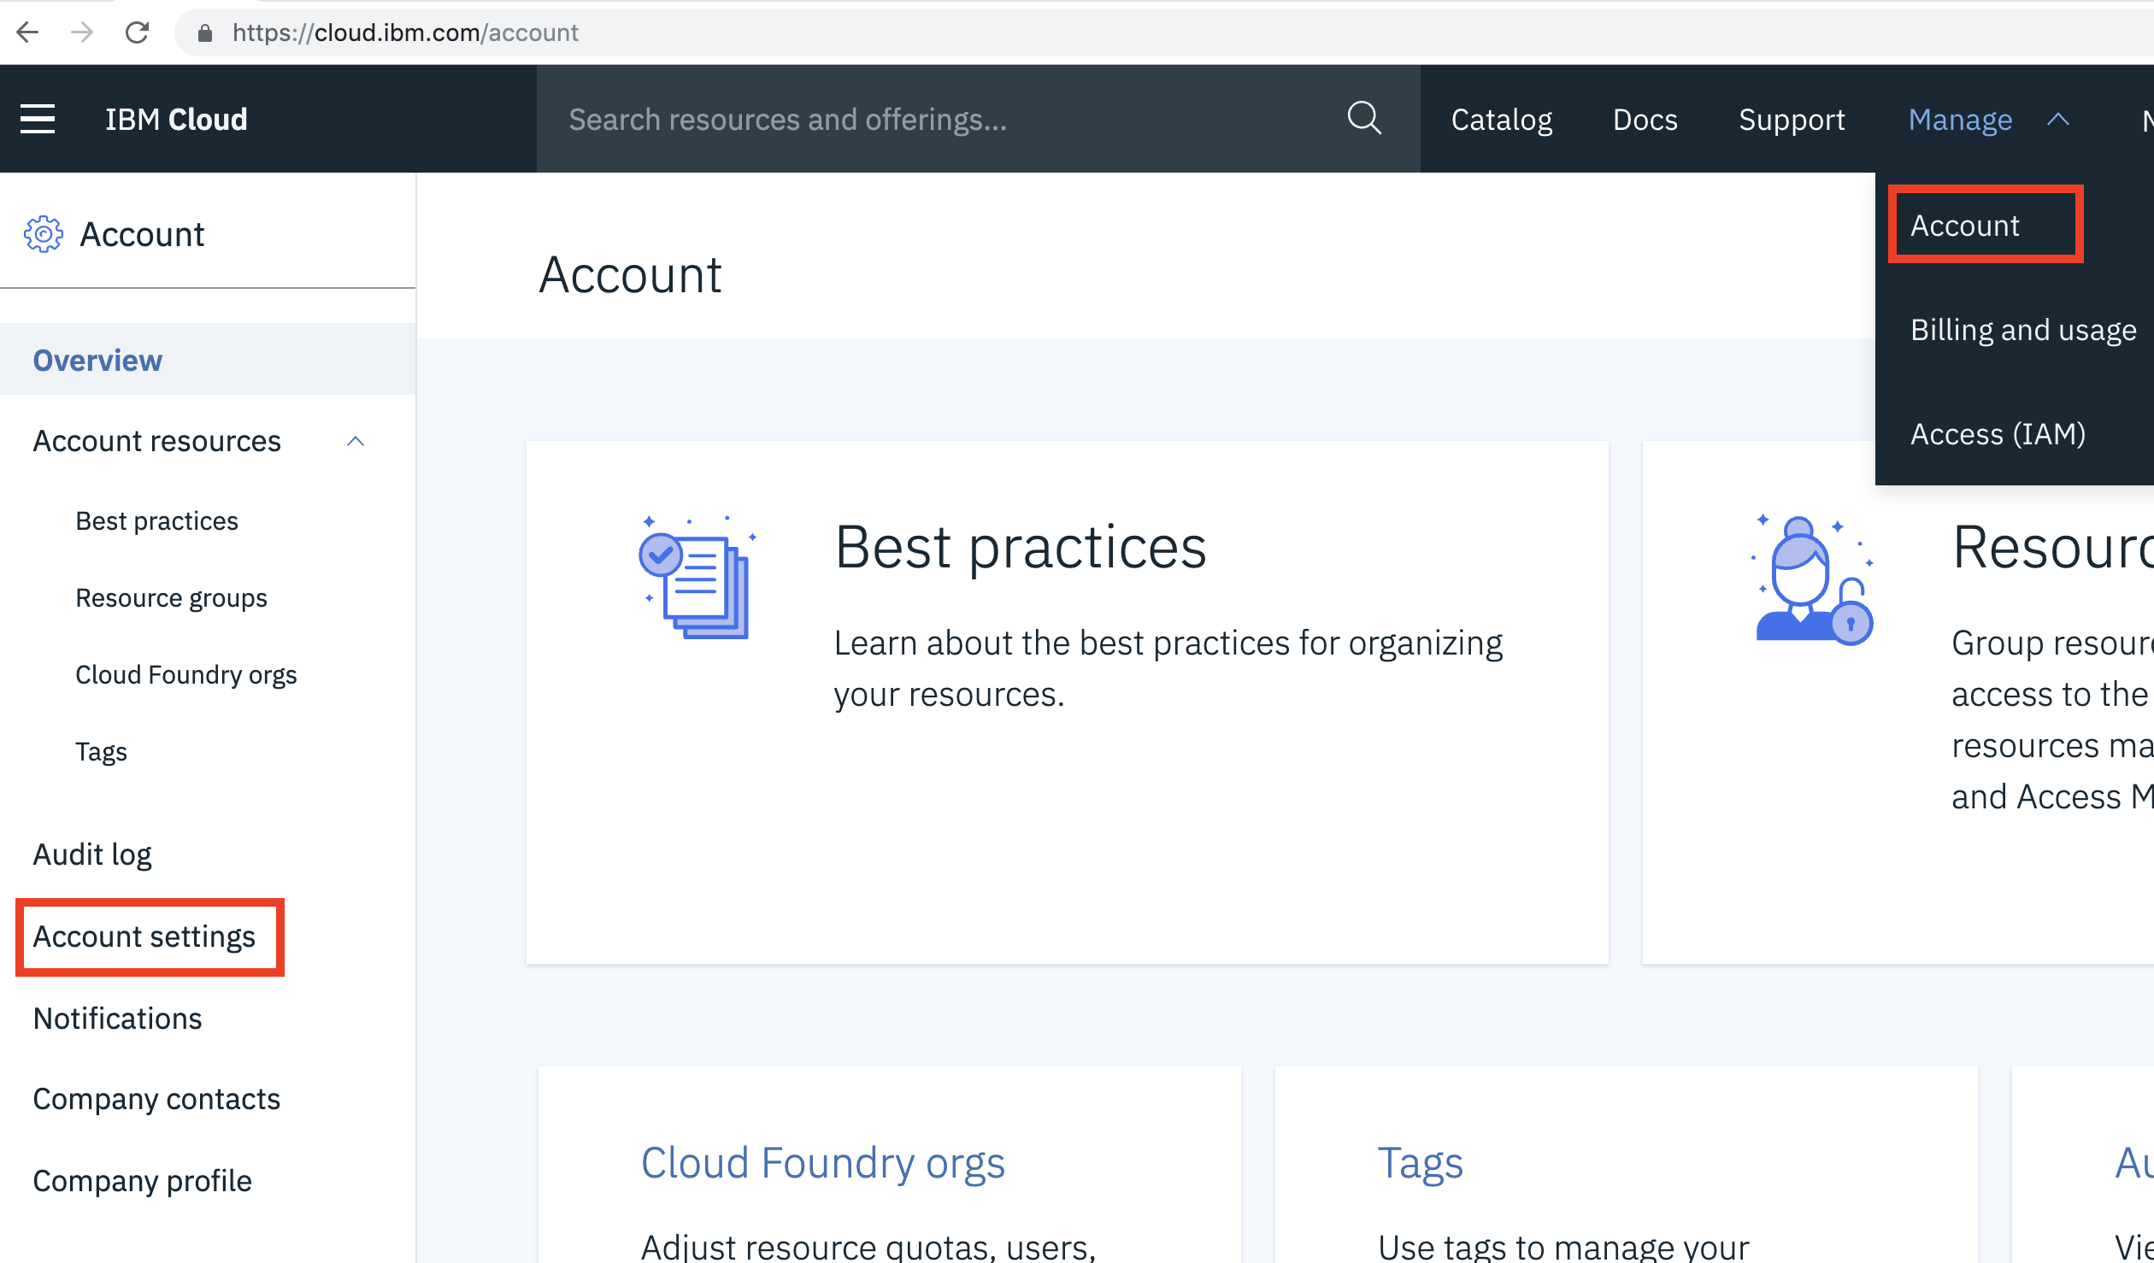
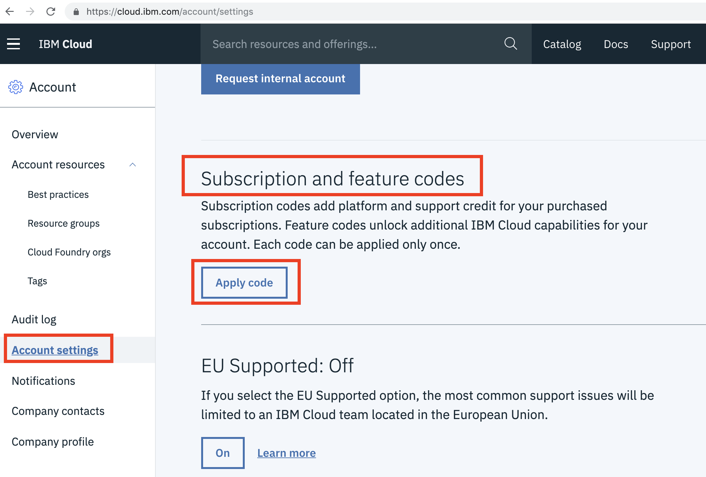
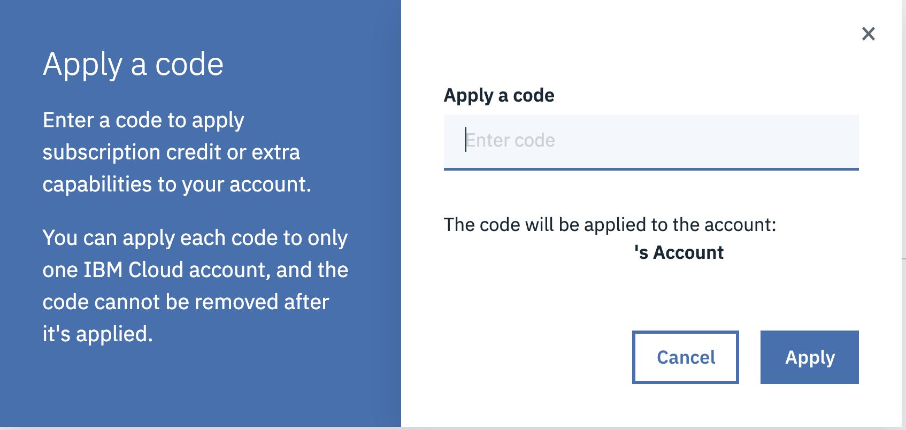
Task 1
Login to the IBM cloud account
https://cloud.ibm.com
Apply PROMO Code
bit.ly/tcskube

Slide 29
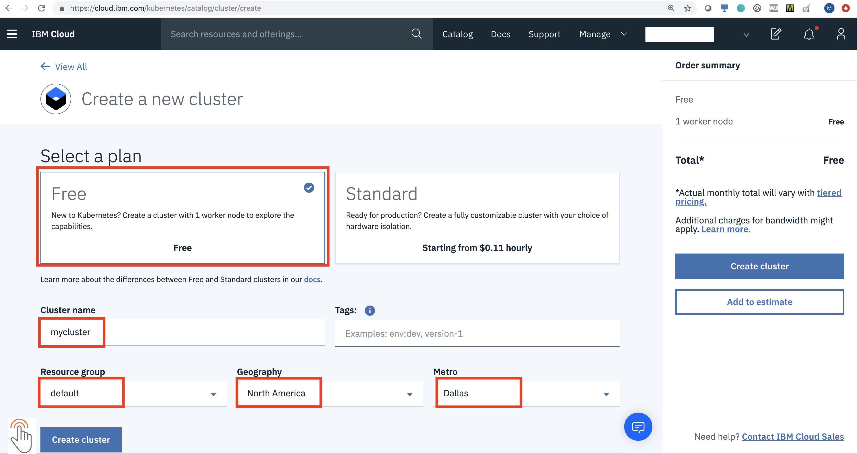
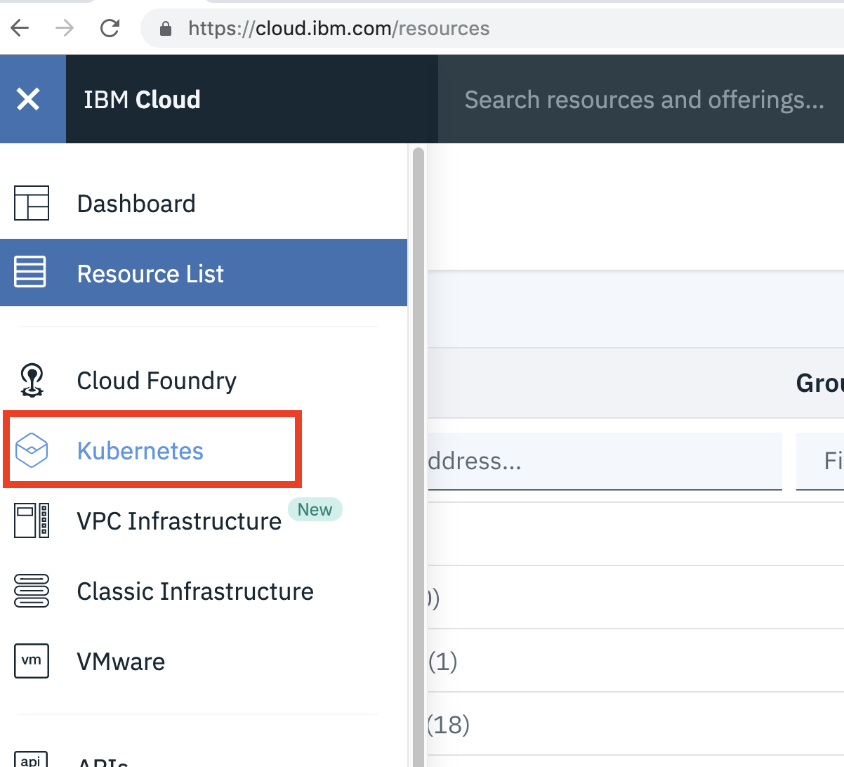
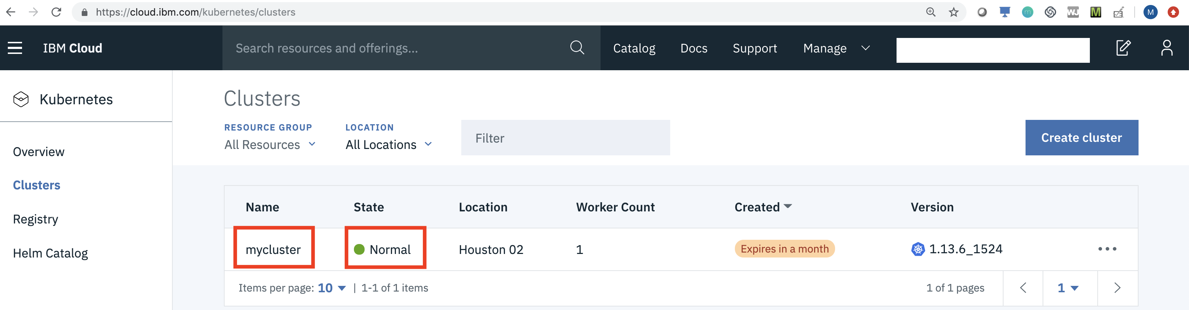
Task 2
Create K8s Free Cluster

Slide 30
You have your kubernetes cluster up and running

Slide 31
Task 3
Deploy a microservice on K8s Cluster created
Client to Co-ordinate with Cluster - Kubectl
( For this lab we will use Web Terminal)
Use Kubectl commands to create k8s Objects
Or YAML/JSON – Language to communicate to master
Create a Deployment using command
- kubectl create deployment
Check your application is deployed

Slide 32
Scaling, Clean up
Task 4
Scale the instances to required number
$ kubectl scale --replicas=10 deployment guestbook
Clean up - Delete the deployment
$ kubectl delete deployment guestbook

Slide 33





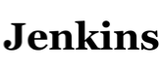
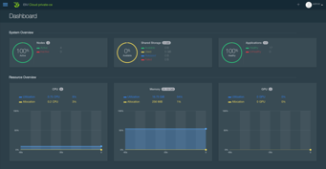



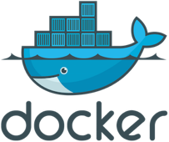


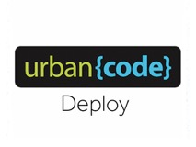



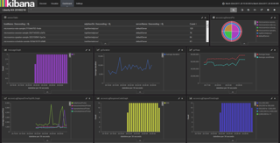






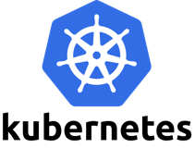
Development modernization and pre-integrated DevOps
DEVELOP
VERSION CONTROL
DEPLOY
MANANGE / MONITOR
BUILD
Test | Pre-Prod | Prod
Microservice Mesh for Kubernetes:
Visibility and control of inter-service communication
…
ELK
Portal
Autoscaling
Intelligent management capabilities
Caching
Healthcheck service
Security
IBM Cloud Private
…
…
Page
33

Slide 34
Educational Courses - Certify your Knowledge
Docker essentials: Extend your apps with containers
https://developer.ibm.com/courses/all/docker-essentials-extend-your-apps-with-containers/
Get started with Kubernetes and IBM Cloud Kubernetes Service
https://developer.ibm.com/courses/all/get-started-kubernetes-ibm-cloud-container-service/
Get started with Istio and IBM Cloud Kubernetes Service
https://developer.ibm.com/courses/all/get-started-istio-ibm-cloud-container-service/
Use the “Develop and test microservices with Kubernetes and Helm” toolchain
https://www.ibm.com/cloud/garage/tutorials/use-develop-test-microservices-with-kubernetes-and-helm-toolchain
Using Istio across public and private clusters - https://developer.ibm.com/patterns/istio-for-multi-clusters-across-iks-and-icp/
https://cognitiveclass.ai/learn/containers-k8s-and-istio-on-ibm-cloud/

Slide 35
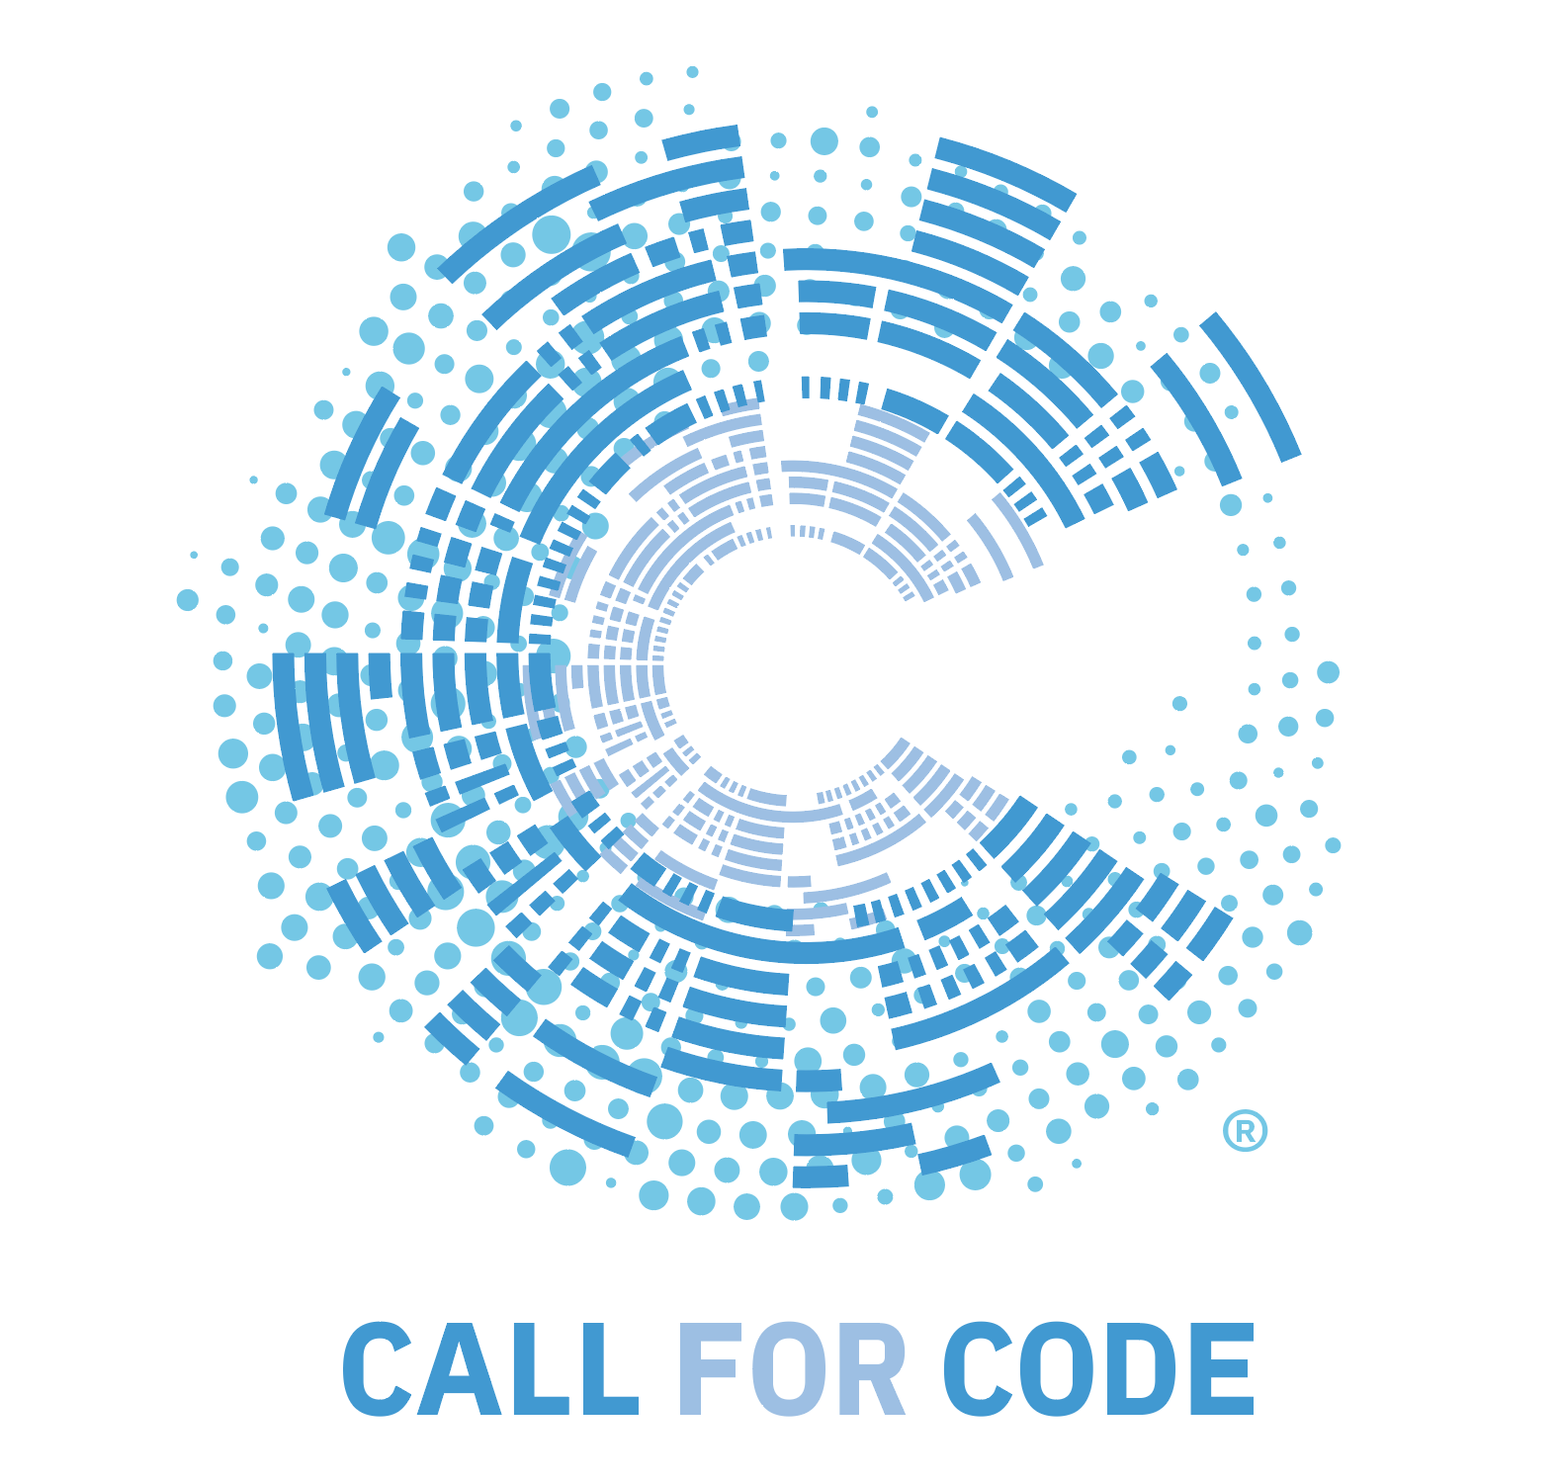



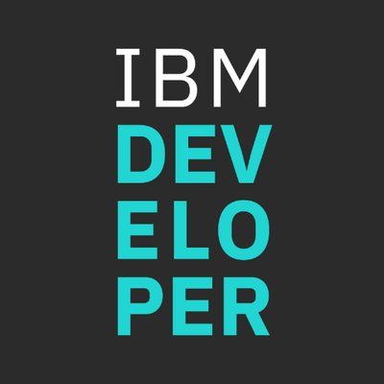

Stay Connected and continue coding !
IBM Coder Platform
https://ibmcoders.influitive.com/
Call for Code 2019
https://developer.ibm.com/callforcode
Code & instructions available here https://github.com/IBMDevConnect
Join our Meetup groups
Mumbai : https://www.meetup.com/Cloud-Mumbai-Meetup/
Hyderabad: https://www.meetup.com/Hyderabad-Cognitive-with-Cloud
Bangalore : https://www.meetup.com/IBMDevConnect-Bangalore
Chennai:
https://www.meetup.com/Chennai-CodeWeekend-Meetup/
Check out the code patterns
https://developer.ibm.com/patterns/
Join our Slack team and stay in touch with the experts
https://ibmdevconnect.slack.com
Send in your request to - http://ibm.biz/slackrequest

Slide 36
Thank you.
Mangesh Patankar,
Developer Advocate
mapatank@in.ibm.com
linkedin: in/Mangesh-patankar
twitter: @MangeshPatank
Saurav Raiguru
Developer Advocate
Saurav.raiguru@in.ibm.com
linkedin: in/sauravraiguru
twitter: @sauravraiguru

